Slide 1
EEOC UPDATE
Robert McMeekin, Supervisory Investigator-Charge Receipt/Technical Information Unit
US EEOC Philadelphia District Office
Philadelphia/Baltimore/Pittsburgh/Cleveland Offices
801 Market Street, Suite 1000 Philadelphia, PA 19107-3127

Slide 2
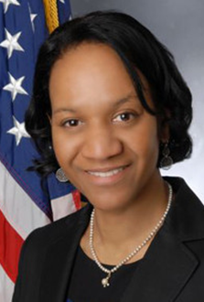
EEOC Chair Burrows
Priorities FY 22
Pay Equity
Racial Justice & Systemic Discrimination
Civil Rights & The Pandemic
Retaliation
Algorithmic Fairness & AI
Sexual Orientation & Gender Identity
Notes:
The U.S. Equal Employment Opportunity Commission (EEOC) is a bipartisan Commission comprised of five presidentially appointed members, including the Chair, Vice Chair, and three Commissioners.
Charlotte A. Burrows was designated by President Biden as Chair of the EEOC on Jan. 20, 2021.
The Commission
Charlotte A. Burrows, Chair
Jocelyn Samuels, Vice Chair
Janet Dhillon, Commissioner
Keith E. Sonderling, Commissioner
Andrea R. Lucas, Commissioner

Slide 3
Don’t forget the Chair’s HIRING INITIATIVES
Please share resources, research and ideas at:
HIRE-initiative@eeoc.gov &
HIRE-initiative@dol.gov.
Notes:
We look forward to engaging a broad array of employers, federal contractors, worker and civil rights organizations, social scientists, and others working to develop innovative recruiting and hiring initiatives.
Round Table discussions are still taking place

Slide 4
Knocking Down Walls: Discrimination and Harassment in Construction
EEOC Hearing was held on May 17, 2022. U.S. Equal Employment Opportunity Commission (EEOC) held a meeting to examine discrimination based on race, national origin. Women and minorities in non-traditional roles
https://www.youtube.com/watch?v=qwtVrzSHSXY

Slide 5
Skills Based Hiring: Removing Barriers and Paving Pathways to Inclusive Workforce
EEOC roundtable discussion was held on June 28 , 2022. U.S. Equal Employment Opportunity Commission (EEOC) with the OFCCP examined hiring and recruiting practices.
https://youtu.be/NrJmgxy8Zhc

Slide 6
Hiring Initiative to Reimagine Equity
Identifying strategies to remove hiring barriers due to race, color, ethnicity, gender, LGBTQ+ status, religion, disability, age and veteran status.
Today, our economy is rebounding and continuing to add jobs, but many communities still face high levels of unemployment. HIRE will work to inform workplace DEIA initiatives by developing a better understanding among employers of the needs and challenges faced by various underrepresented communities. Especially now, as employers confront changing labor market dynamics, many are searching for strategies to recruit and hire from new and diverse talent sources.

Slide 7
Job Advertisements
Recruitment
Application & Hiring
Background Checks
Job Referrals
Job Assignments & Promotions
Pay And Benefits
Notes:
Continue to revisit your job advertisements and knowledge, skills and ability really needed to expand your diversity pool.

Slide 8
U.S. EEOC and U.S. Department of Justice Warn against Disability Discrimination
On May 12, 2022
Employers’ Use of Artificial Intelligence Tools Can Violate the Americans with Disabilities Act
WASHINGTON – The U.S. Equal Employment Opportunity Commission (EEOC) and the U.S. Department of Justice (DOJ) each released a technical assistance document about disability discrimination when employers use artificial intelligence (AI) and other software tools to make employment decisions
https://www.eeoc.gov/laws/guidance/americans-disabilities-act-and-use-software-algorithms-and-artificial-intelligence

Slide 9
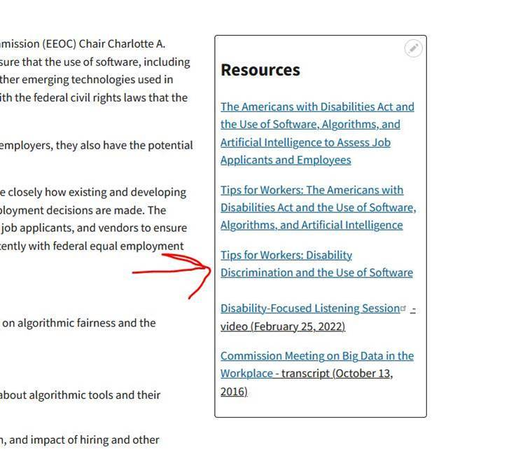
Tips For Workers: Disability Discrimination and the Use of Software
https://www.eeoc.gov/ai
Notes:
This is a new resource, ADA & AI-Worker Tip Sheet. Go to EEOC and use this link that I will provide to Angie.

Slide 10
Look At Your Hiring and Promotion Polices
Algorithms play an increasingly fundamental role in our lives, and the workplace is no exception. Accelerated by the Covid-19 crisis, the adoption of data-driven algorithmic systems that control how, when and where we work has rapidly increased.
Although over 90% of employers claimed to prioritize disability, only 4% included workers with disability in [DEIA] initiatives.”
More than half of the 6,000 global employers surveyed by AARP in 2020 revealed that they do not include age in diversity and inclusion policies.”

Slide 11
EEOC Updated Information
EEOC is updating a number of Q&As on July 12, 2022, including A.6. EEOC’s assessment at the outset of the pandemic was that the ADA standard for conducting medical examinations was, at that time, always met for employers to conduct worksite COVID-19 viral screening testing.
With the revision of A.6, on July 12, 2022, EEOC makes clear that going forward employers will need to assess whether current pandemic circumstances and individual workplace circumstances justify viral screening testing of employees to prevent workplace transmission of COVID-19
Notes:
A.6. offers employers possible factors to consider in making this assessment, including community transmission levels and types of contacts between employees and others in the workplace. This change is not meant to suggest that such testing is or is not warranted; rather, the revised Q&A acknowledges that evolving pandemic circumstances will require an individualized assessment by employers to determine whether such testing is warranted consistent with the requirements of the ADA.

Slide 12
Where can I find more information?
www.eeoc.gov
https://www.eeoc.gov/laws/guidance/americans-disabilities-act-and-use-software-algorithms-and-artificial-intelligence
Click on the tab – Employees & Job Applicants
Click on the tab--www.eeoc.gov/coronavirus.
Click on the tab – Employers/Small Business
Click on the tab – Contact Us to find your nearest EEOC office
EEOC Guidance – What You Should Know: Questions and Answers About the Equal Pay Act
This Photo by Unknown Author is licensed under CC BY-SA-NC

Slide 13
Check out ADA.gov and EEOC.gov
https://www.eeoc.gov/laws/guidance/americans-disabilities-act-and-use-software-algorithms-and-artificial-intelligence
https://www.eeoc.gov/tips-workers-americans-disabilities-act-and-use-software-algorithms-and-artificial-intelligence

Slide 14
EEOC Settlements
EEOC Sues Walmart For Disability Discrimination August 8, 2022
https://www.eeoc.gov/newsroom/eeoc-sues-walmart-disability-discrimination-1
Plains and Copperhead Pipeline Companies Reach Settlement with EEOC for $1.75 Million August 8, 2022
https://www.eeoc.gov/newsroom/plains-and-copperhead-pipeline-companies-reach-settlement-eeoc-175-million
Ring Power Settles EEOC Race Discrimination Case August 8, 2022
https://www.eeoc.gov/newsroom/ring-power-settles-eeoc-race-discrimination-case
Avoid making the EEOC Newsroom
Notes:
AIKEN, S.C. – Wal-Mart Stores East, LP violated federal law when its Aiken, South Carolina retail store failed to provide reasonable accommodation to a part-time sales associate and then placed him on indefinite unpaid leave, the U.S. Equal Employment Opportunity Commission (EEOC) charged in a lawsuit. shortly after hiring after Luis Quiñones, who has a disability, Walmart accommodated Quiñones by permitting him to use one of the store’s electric carts to perform his job duties, which included stocking shelves. Approximately seven months later, and several months after Quiñones had completed his probationary period with the use of the store’s electric cart, a new manager told Quiñones he was no longer able to use the cart and sent him home without pay.
ALBUQUERQUE, N.M. – Four national companies that jointly built and maintained oil & gas pipelines in New Mexico and Texas will pay $1,750,000 and provide other relief to settle a systemic race, national origin and sexual harassment and retaliation lawsuit brought by the U.S. Equal Employment Opportunity Commission (EEOC), the federal agency announced. EEOC’s suit, Plains Pipeline, L.P., Plains All American GP, LLC, Plains Marketing, L.P. and Copperhead Pipeline and Construction, Inc., operating as joint employers of six original complainants and ten additional male oil pipeline workers in southeastern New Mexico – part of the Permian Basin region – subjected the men to harassment based on race (African American), national origin (Native American, Hispanic, and Mexican), and/or sex (male). The EEOC further alleged that the companies then retaliated against them by firing them for complaining about the harassment or associ­ating with coworkers who complained about the harassment.
CAT Equipment Dealer Assigned Black Technician Menial Duties Because of His Race, Federal Agency Charged
AUGUSTINE, Fla. – Ring Power Corporation, North and Central Florida's CAT-brand heavy equipment dealer, has agreed to pay $65,000 and furnish comprehensive injunctive relief to settle a race discrimination lawsuit filed by the U.S. Equal Employment Opportunity Commission (EEOC), the federal agency announced.
Ring Power hired a Black former naval technician to work at its St. Augustine location. He was the only Black technician in his department. Throughout the emp­loyee’s tenure at Ring Power, his supervisor, who was white, made racist remarks about him, including referring to the employee using the “N-word” and stating that he was only good for cleaning. The same supervisor also argued for the Black technician’s termination. Ring Power refused to give the employee technical work assignments and assigned him more menial tasks than the other technicians in his department. Despite multiple complaints to managers and human resources personnel, no corrective action was taken, and the employee resigned.

