Slide 1
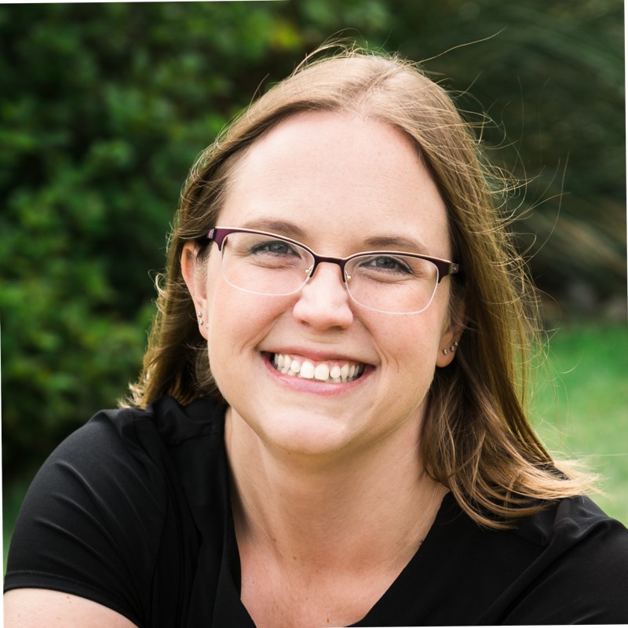
Farewell to Chair Fantine
With gratitude, we want to thank Allison Fantine for her generous leadership efforts as Chair for the PILG.
Your leadership to the board, commitment to our members, and building our network has not went unnoticed.
We look forward to Allison remaining as an active member to support the PILG.

